Slide 1
Edge Computing with Azure IoT

Slide 2
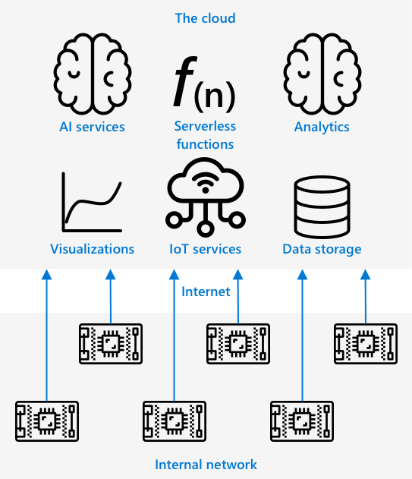
Our work to date
Current Model: Devices gather data and send it to the cloud for analysis.
Uses: AI models, serverless functions.
Limitations: Latency, internet dependency.

Slide 3
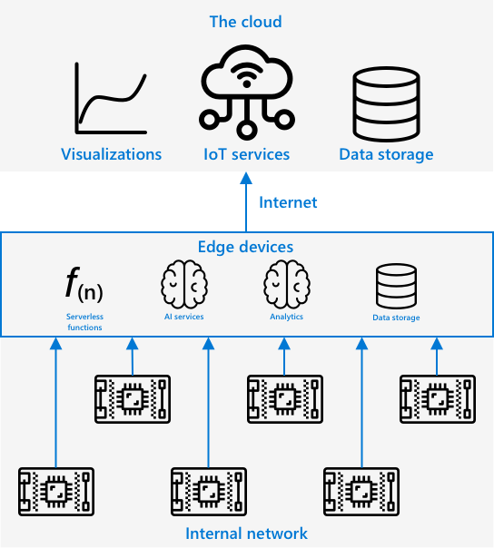
Edge Computing
Edge computing processes IoT data as close as possible to where it is generated, reducing dependence on the cloud.
Key Concept: Moves some cloud services to local networks. Example: Running AI models on edge devices (e.g., fruit ripeness analysis). IoT devices connecting to.

Slide 4
Edge Computing - Benefits
Speed: Faster processing, reduced internet congestion.
Remote Accessibility: Works in low/no connectivity areas.
Lower Costs: Reduces cloud service usage.
Privacy & Security: Keeps sensitive data local.
Handling Insecure Devices: Acts as a secure gateway.
Supports Incompatible Devices: Works as an IoT Hub gateway.

Slide 5
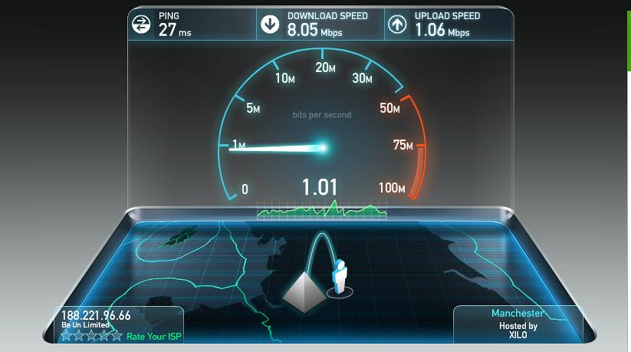
Edge Computing - Speed
Faster network speeds on internal networks.
Reduces latency caused by long-distance cloud communication.
Example: Optical cables allow fast travel but crossing the Atlantic adds delay (~28ms).
This Photo by Unknown Author is licensed under CC BY

Slide 6
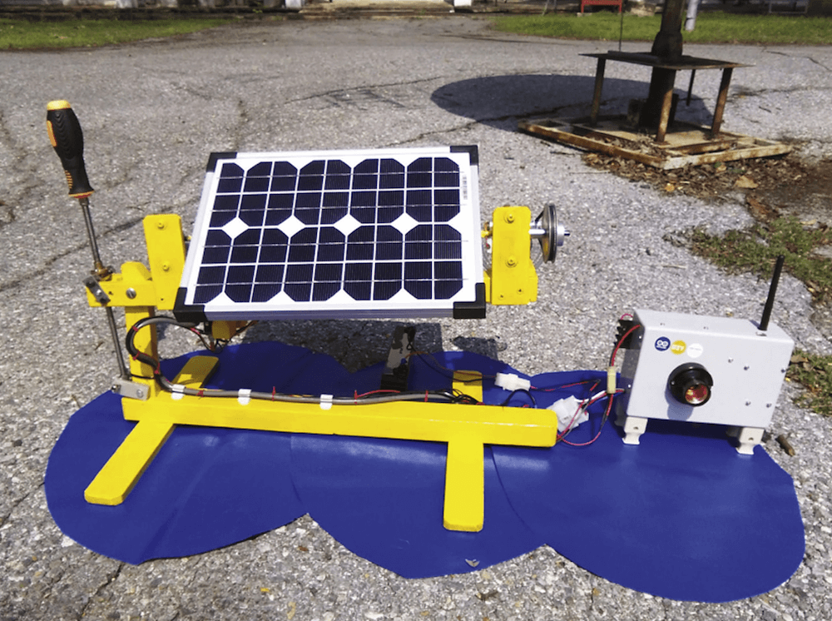
Edge Computing – Remote Locations
Edge computing works in low-connectivity areas.
Useful in humanitarian crises or developing regions.
Example: Local data processing in disaster zones.
This Photo by Unknown Author is licensed under CC BY-SA-NC

Slide 7
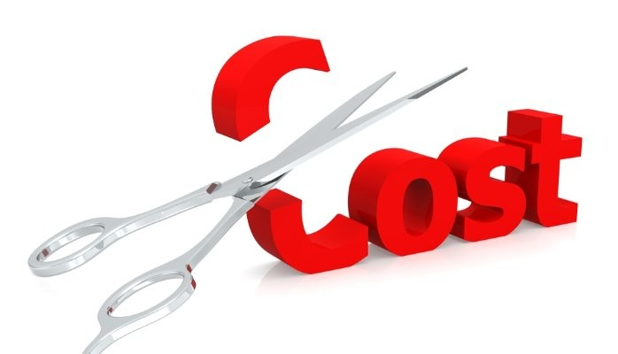
Edge Computing - Costs
Reduces cloud processing and storage expenses.
Affordable AI accelerators (e.g., Jetson Nano).
Example: AI workloads running on inexpensive local devices.
This Photo by Unknown Author is licensed under CC BY-SA-NC

Slide 8
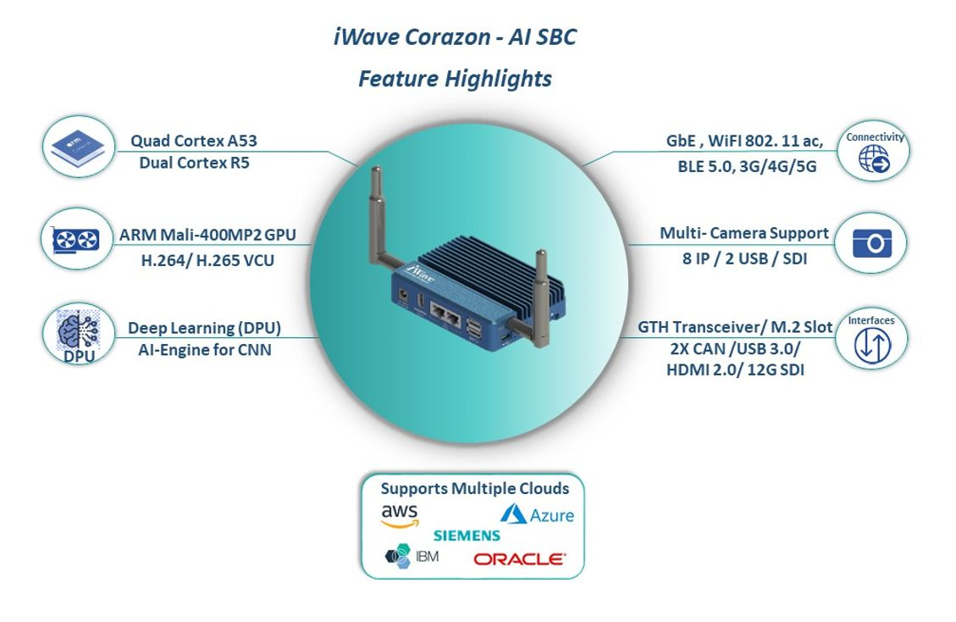
Edge Computing: Privacy
Sensitive data remains on local networks.
Prevents data leaks by reducing cloud storage.
Example: Medical data, security footage(iWave Corazon).
This Photo by Unknown Author is licensed under CC BY-SA

Slide 9
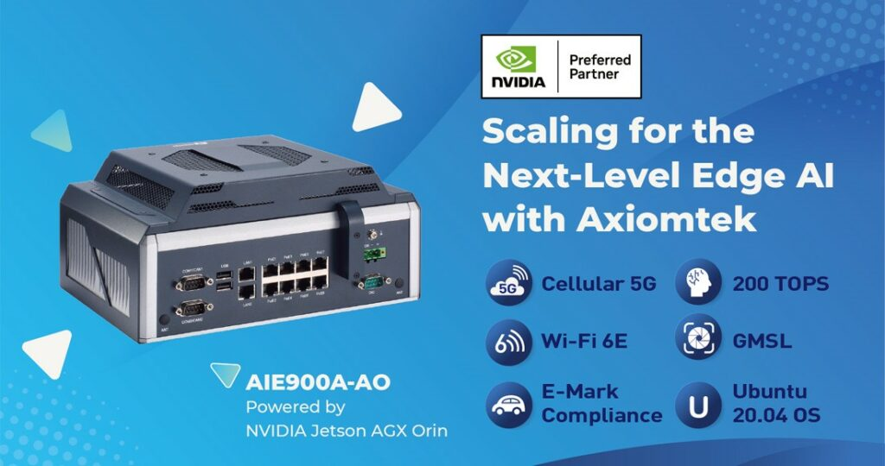
Edge – Insecure/incompatible devices
Can Act as a secure gateway for vulnerable/dodgy devices
Connects devices with limited connectivity options (e.g., Bluetooth-only).
Example: IoT Edge acting as an intermediary.
This Photo by Unknown Author is licensed under CC BY-SA

Slide 10

Edge Computing - Challenges
Scaling & Flexibility: Manual setup required for more devices.
Reliability: Cloud has redundancy; edge requires local investment.
Maintenance: Cloud providers handle updates, edge devices can require manual maintenance(can be mitigated with “over-the-air” depoys.)

Slide 11
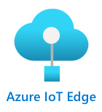
Azure IoT Edge Overview
Service for managing edge workloads.
Deploy and manage from the cloud.
Example: Train an AI model in the cloud, deploy it to an edge device

Slide 12
How IoT Edge Works
Uses Modules: Software components deployed to edge devices.
Built-in Modules: edgeAgent, edgeHub for IoT Hub communication.
Example: Deploy an image classifier to an edge device.

Slide 13
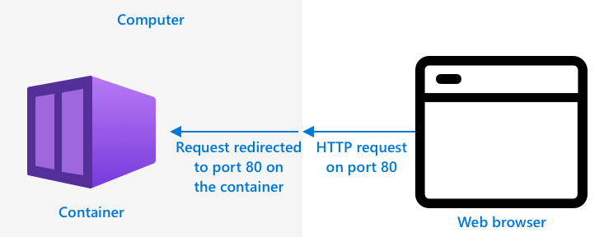
Containers in IoT Edge
Runs workloads in isolated containers.
Containers work like virtual machines but lighter.
Example: AI model deployed in a container.

Slide 14
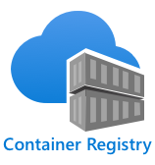
Lab Example- Custom Vision
Deploy image classifiers as containers.
Access local models using REST API.
Example: Custom Vision model running on an edge device instead of cloud.

Slide 15
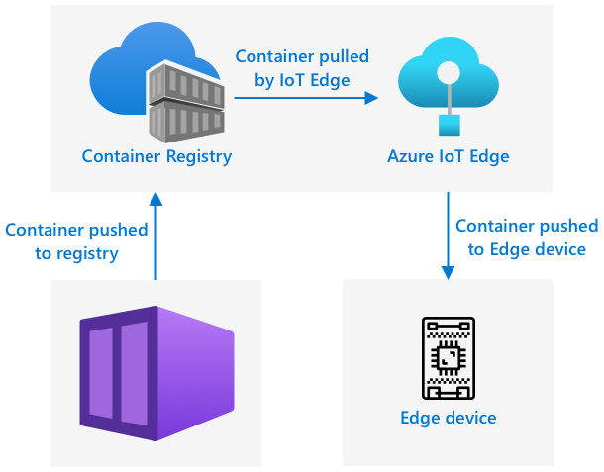
Lab Example – Building Edge Container
Downloaded your classifier model
Build into a container
Push to a container registry on Azure
IoT Edge downloads the container from the registry and push it to the device
The container registry you will use for this lesson is Azure Container Registry

